Slide 2
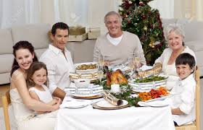

Slide 4
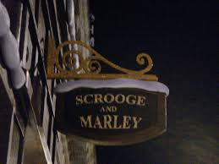

Slide 5
On the fifteenth day of the seventh month, when you have gathered in the produce of the land, you shall celebrate the feast of the LORD seven days. On the first day shall be a solemn rest, and on the eighth day shall be a solemn rest. And you shall take on the first day the fruit of splendid trees, branches of palm trees and boughs of leafy trees and

Slide 6
willows of the brook, and you shall rejoice before the LORD your God seven days. You shall celebrate it as a feast to the LORD for seven days in the year. It is a statute forever throughout your generations; you shall celebrate it in the seventh month. You shall dwell in booths for seven days. All native Israelites shall dwell in booths, that your

Slide 7
generations may know that I made the people of Israel dwell in booths when I brought them out of the land of Egypt: I am the LORD your God.
~Leviticus 23:39-43~

Slide 8
What God Says About Celebrating
God is the Purpose of Our Celebration

Slide 9
Why Go Through All of This?
To Remember
Lights
Caroling
Gifts
Celebrating
Christmas Trees

Slide 10
Why Go Through All of This?
To Remember
Proclaim God to Future Generations

Slide 11
That your generations may know that I made the people of Israel dwell in booths when I brought them out of the land of Egypt: I am the LORD your God.
~v. 43~

Slide 12
What God Says About Celebrating
We Are to Celebrate Joyfully
Rested
Feasted

Slide 13
The tradition of the Jews is that they were to express their joy by dancing, and singing hymns of praise to God, with musical instruments.
~Matthew Henry~

Slide 14
What God Says About Celebrating
The Importance of Celebrating Together—v. 42

Slide 15
Why Community?
Share Joy with One Another
Fosters Encouragement

Slide 16
And let us consider how to stir up one another to love and good works, not neglecting to meet together, as is the habit of some, but encouraging one another, and all the more as you see the Day drawing near.
~Hebrews 10:24-25~

