Slide 2
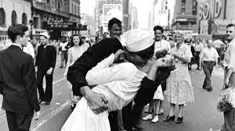

Slide 4
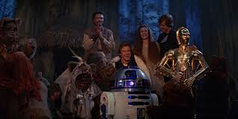
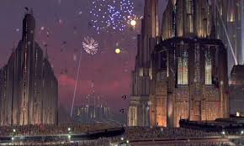
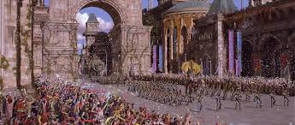

Slide 6
Therefore, since we have been justified by faith, we have peace with God through our Lord Jesus Christ. ² Through him we have also obtained access by faith into this grace in which we stand, and we rejoice in hope of the glory of God. ³ Not only that, but we rejoice in our sufferings, knowing that suffering produces endurance,

Slide 7
⁴ and endurance produces character, and character produces hope, ⁵ and hope does not put us to shame, because God's love has been poured into our hearts through the Holy Spirit who has been given to us. ⁶ For while we were still weak, at the right time Christ died for the ungodly.

Slide 8
⁷ For one will scarcely die for a righteous person—though perhaps for a good person one would dare even to die— ⁸ but God shows his love for us in that while we were still sinners, Christ died for us. ⁹ Since, therefore, we have now been justified by his blood, much more shall we be saved by him from the wrath of God.

Slide 9
¹⁰ For if while we were enemies we were reconciled to God by the death of his Son, much more, now that we are reconciled, shall we be saved by his life. ¹¹ More than that, we also rejoice in God through our Lord Jesus Christ, through whom we have now received reconciliation.

Slide 10
Reasons to Rejoice
We Have Peace with God—v. 1
Therefore, since we have been justified by faith, we have peace with God through our Lord Jesus Christ.

Slide 11
¹³ Greater love has no one than this, that someone lay down his life for his friends. ¹⁴ You are my friends if you do what I command you. ¹⁵ No longer do I call you servants, for the servant does not know what his master is doing; but I have called you friends, for all that I have heard from my Father I have made known to you.

Slide 12
Reasons to Rejoice
We Have Access to God—v. 2a
² Through him we have also obtained access by faith into this grace in which we stand,

Slide 13
Reasons to Rejoice
We Have Hope—v. 2b
and we rejoice in hope of the glory of God.

Slide 14
The reality of God’s love in a believer’s heart gives the assurance, even the guarantee, that the believer’s hope in God and His promise of glory is not misplaced and will not fail.
~John Walvoord~

Slide 15
Reasons to Rejoice
Our Sufferings are not Pointless—v. 3-5

Slide 16
³ Not only that, but we rejoice in our sufferings, knowing that suffering produces endurance, ⁴ and endurance produces character, and character produces hope, ⁵ and hope does not put us to shame, because God's love has been poured into our hearts through the Holy Spirit who has been given to us.

Slide 17
Reasons to Rejoice
We Are Loved—v. 5b-8

Slide 18
Reasons to Rejoice
We Don’t Have to Fear God’s Wrath
⁹ Since, therefore, we have now been justified by his blood, much more shall we be saved by him from the wrath of God.

Slide 19
Reasons to Rejoice
We Have Been Reconciled to God

Slide 20
¹⁰ For if while we were enemies we were reconciled to God by the death of his Son, much more, now that we are reconciled, shall we be saved by his life. ¹¹ More than that, we also rejoice in God through our Lord Jesus Christ, through whom we have now received reconciliation.

