Slide 2
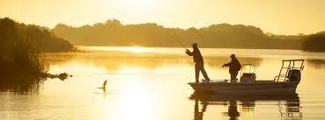

Slide 4
What then shall we say was gained by Abraham, our forefather according to the flesh? ² For if Abraham was justified by works, he has something to boast about, but not before God. ³ For what does the Scripture say? “Abraham believed God, and it was counted to him as righteousness.”

Slide 5
⁴ Now to the one who works, his wages are not counted as a gift but as his due. ⁵ And to the one who does not work but believes in him who justifies the ungodly, his faith is counted as righteousness, ⁶ just as David also speaks of the blessing of the one to whom God counts righteousness apart from works:

Slide 6
“Blessed are those whose lawless deeds are forgiven, and whose sins are covered; ⁸ blessed is the man against whom the Lord will not count his sin.”
⁹ Is this blessing then only for the circumcised, or also for the uncircumcised?

Slide 7
For we say that faith was counted to Abraham as righteousness. ¹⁰ How then was it counted to him? Was it before or after he had been circumcised? It was not after, but before he was circumcised. ¹¹ He received the sign of circumcision as a seal of the righteousness that he had by faith while he was still uncircumcised.

Slide 8
The purpose was to make him the father of all who believe without being circumcised, so that righteousness would be counted to them as well,

Slide 9
¹² and to make him the father of the circumcised who are not merely circumcised but who also walk in the footsteps of the faith that our father Abraham had before he was circumcised.
~Romans 4:1-12~

Slide 10
Faith Reminders
Justification is Proved Right

Slide 11
The Proof
v. 3—Abraham from Genesis 15:6
v. 6-8—David from Psalm 32:1-2

Slide 12
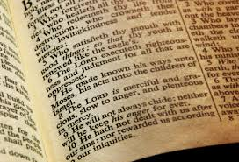

Slide 14
Faith Reminders
Our Faith Doesn’t Save—It’s the Mode—v. 3, 5

Slide 15
Counted—take something that belongs to someone and credit to another’s account

Slide 16
Remember These Lessons
Its Definition—Heb. 11:1
Its Origin—Heb. 12:2
Its Enablement—Mark 9:24

Slide 17
Faith Reminders
Inward Transformation is Necessary before Outward Signs—v. 9-12

Slide 18
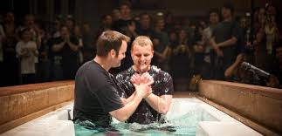
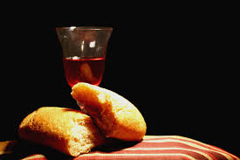

Slide 19
Take This With You
Scripture is the final authority
Our faith is enabled by Christ to respond to Him
Our sins aren’t on our accounts—they’re gone through Grace

